Slide 1
CH 14 Bayesian Networks

Slide 2
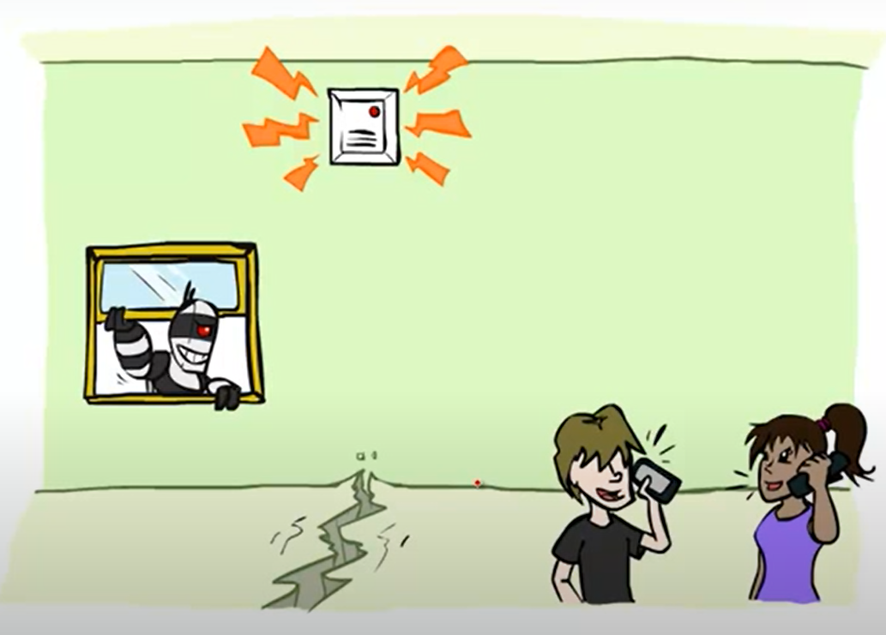
What Bayesian Networks
E
B
A
J
M

Slide 3
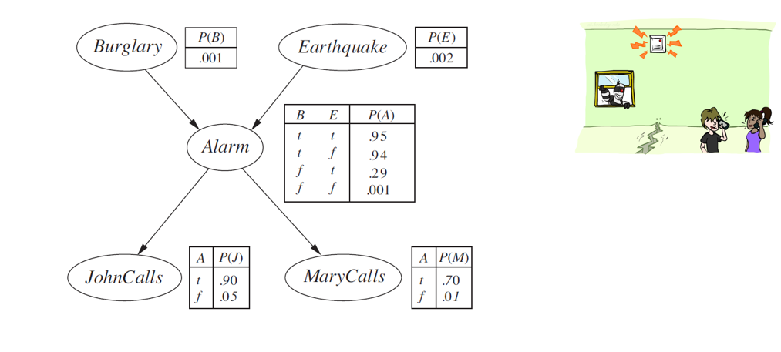

Slide 4
Why Bayesian Networks
P(A,¬E,B,¬M,J) = ?? Old Way !!!
P(A,¬E,B,¬M,J) = P(Node|Parents) that’s it.
P(A,¬E,B,¬M,J) = P(B) *P(¬E) *P(A|¬E,B) *P(¬M|A)* P(J|A)

Slide 5
Golden Rules
P(A|B)=P(A,B)/P(B)
P(A,B) =P(A|B)*P(B) = P(B|A) * P(A)
In Case of A and B are independent
P(A,B) =P(A)P(B)
P(A,B|C) =P(A|C)P(B|C)

Slide 6
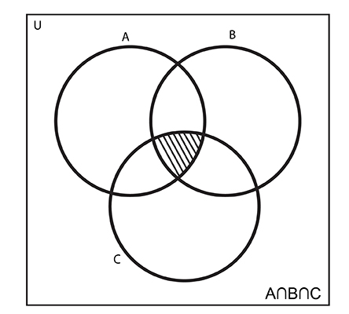
Marginal distribution
P(A,B) = P(A,B ,C) +P(A,B,¬C)
P(A) = P(A,B ,C) + P(A,B,¬C) + P(A,¬B ,C) + P(A,¬B,¬C)

Slide 7
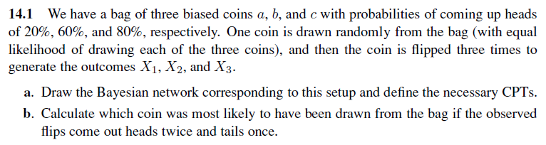

Slide 8
Z | P(X=head|Z) Same For X1,X2,X3 | P(X=tail|Z) Same For X1,X2,X3
Z = a | 0.2 | 0.8
Z = b | 0.6 | 0.4
Z = c | 0.8 | 0.8
Z | P(Z)
Z = a | 1/3
Z = b | 1/3
Z = c | 1/3
Z
X₁
X₂
X₃
Assumptions:
Z is the type of the coin taken from the bag.
X is true if the flip resulted in a head, and false if tail.
Notes:
B.
P(Z | X₁, X₂, ¬X₃) = P(X₁, X₂, ¬X₃| Z) P(Z) / P(X₁, X₂, ¬X₃| Z) = 𝛼 P(X₁, X₂, ¬X₃| Z) P(Z) = 𝛼 P(X₁| Z) P(X₂| Z) P(¬X₃| Z) P(Z)
P(Z=a | X₁, X₂, ¬X₃) = 𝛼 * 0.2 * 0.2 * (1 - 0.2) * (1/3) = 𝛼 * 0.032/3
P(Z=b | X₁, X₂, ¬X₃) = 𝛼 * 0.6 * 0.6 * (1 - 0.6) * (1/3) = 𝛼 * 0.144/3
P(Z=c | X₁, X₂, ¬X₃) = 𝛼 * 0.8 * 0.8 * (1 - 0.8) * (1/3) = 𝛼 * 0.128/3
So the coin is most likely to be of type “b”
If we want to calculate probabilities, we continue as follows:
Since P(Z=a | X₁, X₂, ¬X₃) + P(Z=b | X₁, X₂, ¬X₃) + P(Z=c | X₁, X₂, ¬X₃) = 1
So 𝛼 = 1/(0.032/3 + 0.144/3 + 0.128/3) = 3/0.304
P(Z=a | X₁, X₂, ¬X₃) = 0.032/0.304 ≅ 0.105
P(Z=b | X₁, X₂, ¬X₃) = 0.144/0.304 ≅ 0.474
P(Z=c | X₁, X₂, ¬X₃) = 0.128/0.304 ≅ 0.421

Slide 9
P(Z=a | X1,X2,¬X3) =?
P(Z=b | X1,X2,¬X3) =?
P(Z=c | X1,X2,¬X3) =?
P(Z=a | X1,X2,¬X3) = P(Z=a,X1,X2,¬X3) / P(X1,X2,¬X3)
= P(Z=a,X1,X2,¬X3) *𝛼
= P(X1,X2,¬X3|Z=a) *P(Z=a) * 𝛼
=P(X1|Z=a)*P(X2|Z=a)* P(¬X3|Z=a) *P(Z=a) * 𝛼
Similarly :
P(Z=b | X1,X2,¬X3)=P(X1|Z=b)*P(X2|Z=b)* P(¬X3|Z=b) *P(Z=b) * 𝛼
P(Z=c | X1,X2,¬X3)=P(X1|Z=c)*P(X2|Z=c)* P(¬X3|Z=c) *P(Z=c) * 𝛼

Slide 10
P(Z=a | X₁, X₂, ¬X₃) = 𝛼 * 0.2 * 0.2 * (1 - 0.2) * (1/3) = 𝛼 * 0.032/3
P(Z=b | X₁, X₂, ¬X₃) = 𝛼 * 0.6 * 0.6 * (1 - 0.6) * (1/3) = 𝛼 * 0.144/3
P(Z=c | X₁, X₂, ¬X₃) = 𝛼 * 0.8 * 0.8 * (1 - 0.8) * (1/3) = 𝛼 * 0.128/3
So the coin is most likely to be of type “b”
If we want to calculate probabilities, we continue as follows:
1/𝛼 = P(X₁, X₂, ¬X₃)
= P(X₁, X₂, ¬X₃ ,Z=a) +P(X₁, X₂, ¬X₃ ,Z=b) +P(X₁, X₂, ¬X₃ ,Z=c)
= P(X₁, X₂, ¬X₃|Z=a)P(Z=a) +
P(X₁, X₂, ¬X₃|Z=b)P(Z=b) +
P(X₁, X₂, ¬X₃|Z=c)P(Z=c)
So 1/𝛼 = 0.032/3 + 0.144/3 + 0.128/3 = 3/0.304
P(Z=a | X₁, X₂, ¬X₃) = 0.032/0.304 ≅ 0.105
P(Z=b | X₁, X₂, ¬X₃) = 0.144/0.304 ≅ 0.474
P(Z=c | X₁, X₂, ¬X₃) = 0.128/0.304 ≅ 0.421

Slide 11
Another way to find 𝛼
1/𝛼 = P(X₁, X₂, ¬X₃)
= P(X₁, X₂, ¬X₃ ,Z=a) +P(X₁, X₂, ¬X₃ ,Z=b) +P(X₁, X₂, ¬X₃ ,Z=c)
= P(,Z=a | X₁, X₂, ¬X₃ )P(X₁, X₂, ¬X₃ )+
P(Z=b | X₁, X₂, ¬X₃ )P(X₁, X₂, ¬X₃ )+
P(Z=c | X₁, X₂, ¬X₃ )P(X₁, X₂, ¬X₃ )
So
P(,Z=a | X₁, X₂, ¬X₃ )+ P(Z=b | X₁, X₂, ¬X₃ )+ P(Z=c | X₁, X₂, ¬X₃ ) must = 1.
So If we want to calculate probabilities, we continue as follows:
Since P(Z=a | X₁, X₂, ¬X₃) + P(Z=b | X₁, X₂, ¬X₃) + P(Z=c | X₁, X₂, ¬X₃) = 1
So 𝛼 = 1/(0.032/3 + 0.144/3 + 0.128/3) = 3/0.304
P(Z=a | X₁, X₂, ¬X₃) = 0.032/0.304 ≅ 0.105
P(Z=b | X₁, X₂, ¬X₃) = 0.144/0.304 ≅ 0.474
P(Z=c | X₁, X₂, ¬X₃) = 0.128/0.304 ≅ 0.421

Slide 12
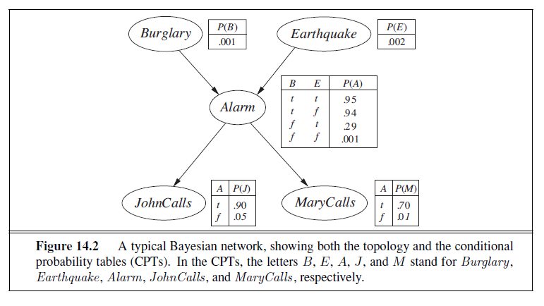
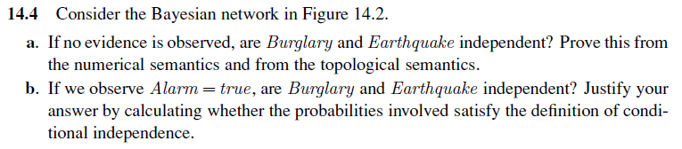
Notes:
A.
For the numerical proof, we would need to sample a lot of samples of the RVs and compute P(Burglary, Earthquake), P(Burglary) and P(Earthquake) then show that P(Burglary, Earthquake) = P(Burglary) * P(Earthquake) as the samples tend to infinity but that is infeasible so instead, we will emulate the process and compute the weights as follows.
First of all, we can sample from the network by sampler in a topological order:
Sample from “Burglary”. [P(Burglary)]
Sample from “Earthquake”. [P(Earthquake)]
Sample from “Alarm” given the sampled values of “Burglary” and “Earthquake”. [P(Alarm | Burglary, Earthquake)]
Sample from “JohnCalls” given the sampled value of “Alarm”. [P(JohnCalls | Alarm)]
Sample from “MaryCalls” given the sampled value of “Alarm”. [P(MaryCalls | Alarm)]
For the sake of simplicity, let us ignore “JohnCalls” and “MaryCalls” since they don’t depend on “Burglary” & “Earthquake” GIVEN “Alarm”.
So the probability of a certain tuple of values P(Burglary, Earthquake, Alarms) should be the product of the probability of each of value resulting from each sampling step (1 to 3) which will be: P(Burglary) * P(Earthquake) * P(Alarm | Burglary, Earthquake)
To compute P(Burglary, Earthquake) we need to sum P(Burglary, Earthquake, Alarm) over all possible values of “Alarm”, so
P(Burglary, Earthquake) = sum(P(Burglary) * P(Earthquake) * P(Alarm | Burglary, Earthquake)) over all possible values of “Alarm”
= P(Burglary) * P(Earthquake) * P(Alarm | Burglary, Earthquake) + P(Burglary) * P(Earthquake) * P(¬Alarm | Burglary, Earthquake)
By taking P(Burglary) * P(Earthquake) as a common factor, we end up with:
P(Burglary, Earthquake) = P(Burglary) * P(Earthquake) * (P(Alarm | Burglary, Earthquake) + P(¬Alarm | Burglary, Earthquake))
Since (P(Alarm | Burglary, Earthquake) + P(¬Alarm | Burglary, Earthquake)) = 1
P(Burglary, Earthquake) = P(Burglary) * P(Earthquake)
-----------------------------------------------
From the topological semantics, “Burglary” and “Earthquake” are d-separated so they are independent.
What is d-separation? This website does a great job at explaining it: http://bayes.cs.ucla.edu/BOOK-2K/d-sep.html
To understand “d-separation”, we have to understand the concept of “collider”. A collider is node where the arrows along the path of interest face head-to-head. For example:
In A -> B <- C, the node B is a collider for the path “A, B, C” since the arrows face head to head at it.
In A -> B -> C, the node B is not a collider for the path “A, B, C”.
In A <- B -> C, the node B is not a collider for the path “A, B, C”.
The d-separation rules are:
x and y are d-connected if there is an unblocked path (has no colliders) between them.
x and y are d-connected, conditioned on a set Z of nodes, if there is a collider-free path between x and y that traverses no member of Z. If no such path exists, we say that x and y are d-separated by Z, We also say then that every path between x and y is "blocked" by Z.
If a collider is a member of the conditioning set Z, or has a descendant in Z, then it no longer blocks any path that traces this collider.
Another way is that Given the parents of “Burglary” (there are none), Burglary is independent on any non-descendant (which includes “Earthquake”). Therefore “Burglary” and “Earthquake” are independent.
----------------------------------------
B.
No, Burglary and Earthquake are not independent given Alarm.
To show that they are dependant, we have to show that P(Burglary, Earthquake | Alarm) ≠ P(Burglary | Alarm) * P(Earthquake | Alarm) for any set of values.
P(Burglary, Earthquake | Alarm) = P(Alarm | Burglary, Earthquake) P(Burglary, Earthquake) / P(Alarm) = P(Alarm | Burglary, Earthquake) P(Burglary) P(Earthquake) / P(Alarm)
P(Burglary, Earthquake | Alarm) = 𝛼 P(Alarm | Burglary, Earthquake) P(Burglary) P(Earthquake)
P(Burglary, Earthquake | Alarm) = 𝛼 0.95 * 0.001 * 0.002 = 𝛼 0.0000019
P(Burglary, ¬Earthquake | Alarm) = 𝛼 0.94 * 0.001 * 0.998 = 𝛼 0.00093812
P(¬Burglary, Earthquake | Alarm) = 𝛼 0.29 * 0.999 * 0.002 = 𝛼 0.00057942
P(¬Burglary, ¬Earthquake | Alarm) = 𝛼 0.001 * 0.999 * 0.998 = 𝛼 0.000997002
𝛼 = 397.3864686728325
P(Burglary, Earthquake | Alarm) = 0.0007550342904783818
P(Burglary, ¬Earthquake | Alarm) = 0.3727961939913576
P(¬Burglary, Earthquake | Alarm) = 0.2302536676784126
P(¬Burglary, ¬Earthquake | Alarm) = 0.3961951040397514
P(Burglary | Alarm) = P(Burglary, Earthquake | Alarm) + P(Burglary, ¬Earthquake | Alarm) = 0.0007550342904783818 + 0.3727961939913576 = 0.373551228281836
P(Earthquake | Alarm) = P(Burglary, Earthquake | Alarm) + P(¬Burglary, Earthquake | Alarm) = 0.0007550342904783818 + 0.2302536676784126 = 0.231008701968891
P(Burglary | Alarm) P(Earthquake | Alarm) = 0.0862935843642718
P(Burglary, Earthquake | Alarm) = 0.0007550342904783818
So P(Burglary, Earthquake | Alarm) ≠ P(Burglary | Alarm) * P(Earthquake | Alarm)

Slide 13
B. No, Burglary and Earthquake are not independent given Alarm.
To show that they are dependant, we have to show that
P(B, E | A) ≠ P(B | A) * P(E | A)
LHS
P(B, E | A) = P(A, E,B)/P(A)
= P(A | B, E) P(B, E) / P(A)
= P(A | B, E) P(B) P(E) / P(A)
= 0.95 * 0.001 * 0.002 / P(A)
P(A) = P(A, E,B)+ P(A, ¬E,B)+ P(A, E, ¬B)+ P(A, ¬E, ¬B)
= P(A | B, E) P(B) P(E) +
P(A | ¬B, E) P(¬ B) P(E)+
P(A | B, ¬E) P(B) P(¬ E)+
P(A | ¬B, ¬E) P(¬ B) P(¬ E)
= 0.95 * 0.001 * 0.002 +0.94 * 0.001 * 0.998 + 0.29 * 0.999 * 0.002 +
0.001 * 0.999 * 0.998 = 0.00251644
So, LHS P(B, E | A) = 0.95 * 0.001 * 0.002 / P(A) = 0.000755034

Slide 14
RHS P(B | A) P(E| A)
P(B | A) =
P(B, E | A) + P(B, ¬E | A) = 0.000755 + 0.3727 = 0.37355
P(E | A) =
P(B, E | A) + P(¬B, E | A) = 0.000755+ 0.2302 = 0.231
So, RHS P(B | A) P(E| A) = 0.0862935843642718
, and LHS P(B, E | A) = 0.000755034
So P(B, E | A) ≠ P(B | A) * P(E| A)

Slide 15
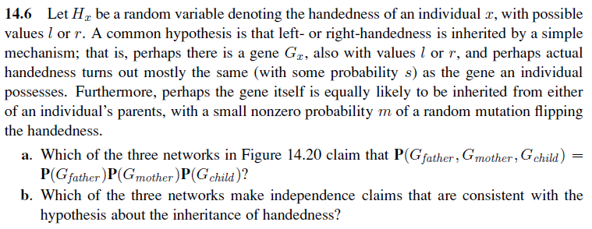
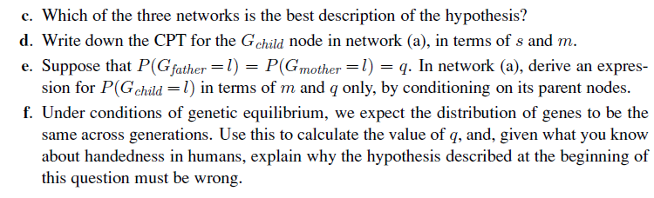

Slide 17
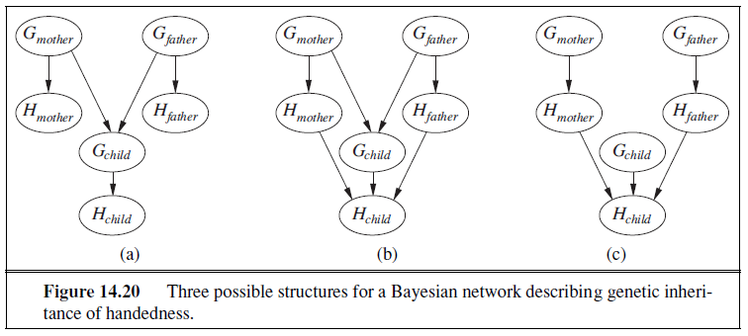
Notes:
A.
Figure (c).
B.
Figure (a) and (b). There are extra unneeded arcs but they don’t violate the conditional dependence.
C.
Figure (a) since it represents the dependencies correctly with less arcs (more efficient).
D.
Assuming Gc, Gm, Gf means the the child, the mother and the father are left-handed respectively.
P(Gc | Gm, Gf) = 1 - m
P(Gc | Gm, ¬Gf) = 0.5
P(Gc | ¬Gm, Gf) = 0.5
P(Gc | ¬Gm, ¬Gf) = m
Assuming H means the individual is left-handed.
P(H | G) = s
P(H | ¬G) = 1 - s
E.
P(Gc) = sum P(Gc | Gm, Gf)P(Gm)P(Gf) over all values of Gm, Gf =
P(Gc) = (1-m)*q*q + 0.5*q*(1-q) + 0.5*(1-q)*q + m*(1-q)*(1-q)
= q^2 - m*q^2 + q - q^2 + m - m*2*q + m*q^2
= q + m - 2mq
F.
Equilibrium means the P(G) should be the same across generations so
P(Gc) = P(Gm) = P(Gf) = q
q + m - 2mq = q
m = 2mq
Since m > 0,
1 = 2q
So q = 0.5
Which means that there is a 50% that any person is left-handed and 50% that they are right-handed.
This is not true in reality so we can infer that the hypothesis proposed by the question is wrong.

Slide 18
Notes:
A.
Figure (c).
B.
Figure (a) and (b). There are extra unneeded arcs but they don’t violate the conditional dependence.
C.
Figure (a) since it represents the dependencies correctly with less arcs (more efficient).
D.
Assuming Gc, Gm, Gf means the the child, the mother and the father are left-handed respectively.
P(Gc | Gm, Gf) = 1 - m
P(Gc | Gm, ¬Gf) = 0.5
P(Gc | ¬Gm, Gf) = 0.5
P(Gc | ¬Gm, ¬Gf) = m
Assuming H means the individual is left-handed.
P(H | G) = s
P(H | ¬G) = 1 - s
E.
P(Gc) = sum P(Gc | Gm, Gf)P(Gm)P(Gf) over all values of Gm, Gf =
P(Gc) = (1-m)*q*q + 0.5*q*(1-q) + 0.5*(1-q)*q + m*(1-q)*(1-q)
= q^2 - m*q^2 + q - q^2 + m - m*2*q + m*q^2
= q + m - 2mq
F.
Equilibrium means the P(G) should be the same across generations so
P(Gc) = P(Gm) = P(Gf) = q
q + m - 2mq = q
m = 2mq
Since m > 0,
1 = 2q
So q = 0.5
Which means that there is a 50% that any person is left-handed and 50% that they are right-handed.
This is not true in reality so we can infer that the hypothesis proposed by the question is wrong.

Slide 19
Notes:
A.
Figure (c).
B.
Figure (a) and (b). There are extra unneeded arcs but they don’t violate the conditional dependence.
C.
Figure (a) since it represents the dependencies correctly with less arcs (more efficient).
D.
Assuming Gc, Gm, Gf means the the child, the mother and the father are left-handed respectively.
P(Gc | Gm, Gf) = 1 - m
P(Gc | Gm, ¬Gf) = 0.5
P(Gc | ¬Gm, Gf) = 0.5
P(Gc | ¬Gm, ¬Gf) = m
Assuming H means the individual is left-handed.
P(H | G) = s
P(H | ¬G) = 1 - s
E.
P(Gc) = sum P(Gc | Gm, Gf)P(Gm)P(Gf) over all values of Gm, Gf =
P(Gc) = (1-m)*q*q + 0.5*q*(1-q) + 0.5*(1-q)*q + m*(1-q)*(1-q)
= q^2 - m*q^2 + q - q^2 + m - m*2*q + m*q^2
= q + m - 2mq
F.
Equilibrium means the P(G) should be the same across generations so
P(Gc) = P(Gm) = P(Gf) = q
q + m - 2mq = q
m = 2mq
Since m > 0,
1 = 2q
So q = 0.5
Which means that there is a 50% that any person is left-handed and 50% that they are right-handed.
This is not true in reality so we can infer that the hypothesis proposed by the question is wrong.

Slide 20
Assuming Gc, Gm, Gf means the child, the mother and the father are left-handed respectively.
Assuming H means the individual is left-handed.
Gm | Gf | P(Gc|Gm,Gf)
T | T | 1-m
T | F | 0.5
F | T | 0.5
F | F | m
Gc | P(Hc|Gc)
T | S
F | 1-S

Slide 21
P(Gc) = sum P(Gc | Gm, Gf)P(Gm)P(Gf) over all values of Gm, Gf
P(Gc) = P(Gc | Gm, Gf)P(Gm)P(Gf) +
P(Gc | ¬Gm, Gf)P(¬Gm)P(Gf)+
P(Gc | Gm, ¬Gf)P(Gm)P(¬Gf) +
P(Gc | ¬Gm,¬ Gf) P(¬Gm)P(¬Gf)
P(Gc) = (1-m)*q*q +
0.5*q*(1-q) +
0.5*(1-q)*q +
m*(1-q)*(1-q)
= q^2 - m*q^2 + q - q^2 + m - m*2*q + m*q^2
= q + m - 2mq
Gm | Gf | P(Gc| Gm , Gf)
T | T | 1-m
T | F | 0.5
F | T | 0.5
F | F | m
Gc | P(Hc| Gc)
T | S
F | 1-S

Slide 22
Equilibrium means the P(G) should be the same across generations so
P(Gc) = P(Gm) = P(Gf) = q
q + m - 2mq = q
m = 2mq
Since m > 0,
1 = 2q
So q = 0.5
Which means that there is a 50% that any person is left-handed and 50% that they are right-handed.
This is not true in reality so we can infer that the hypothesis proposed by the question is wrong.

Slide 23
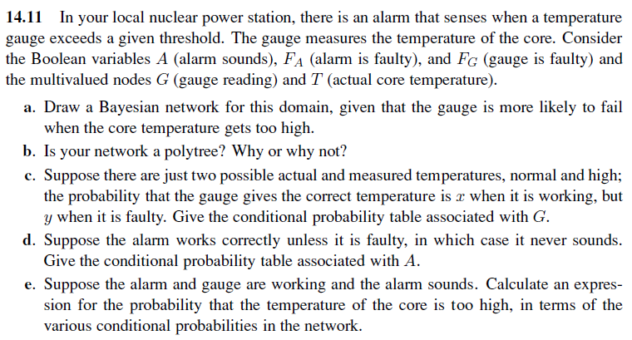

Slide 24
T
G
A
F_{G}
F_{A}

Slide 25
T | F_{G} | P(G=H|T,F_{G}) | P(G=N|T,F_{G})
N | T | y | 1-y
H | F | 1-y | Y
N | T | x | 1-x
H | F | 1-x | x
T
G
A
F_{G}
F_{A}

Slide 26
G | F_{A} | P(A = s|G, F_{A}) | P(A =!s|G, F_{A})
N | T | 0 | 1
H | T | 0 | 1
N | F | 0 | 1
H | F | 1 | 0
T
G
A
F_{G}
F_{A}

Slide 27
T
G
A
F_{G}
F_{A}
T | F_{G} | P(G=H|T,F_{G}) | P(G=N|T,F_{G})
N | T | y | 1-y
H | F | 1-y | Y
N | T | x | 1-x
H | F | 1-x | x
G | F_{A} | P(A=s|G,F_{A}) | P(A=!s|G,F_{A})
N | T | 0 | 1
H | T | 0 | 1
N | F | 0 | 1
H | F | 1 | 0

Slide 28
Let t mean T = High (H)
Let g mean G = High(H)
Let f_{G} mean F_{G} = Faulty(T)
Let f_{A} mean F_{A} = Faulty(T)
Let a mean A = sounds(S)
P(t | a, ¬f_{G}, ¬f_{A}) = P (t , a, ¬f_{G}, ¬f_{A}) /P( a, ¬f_{G}, ¬f_{A}) let 𝛼 = 1/P( a, ¬f_{G}, ¬f_{A})
= 𝛼 * [P (t ,G, a, ¬f_{G}, ¬f_{A}) + P (t ,¬G, a, ¬f_{G}, ¬f_{A}) )]
= 𝛼 * [ P (a|G,¬f_{A}) *P (G|t, ¬f_{G}) P ( ¬f_{G}|t) P(t) P(¬f_{A})
+ P (a|¬G,¬f_{A}) *P (¬G|t, ¬f_{G}) P ( ¬f_{G}|t) P(t) P(¬f_{A}) ]
Since P(a|¬G,¬f_{A}) = 0, so the term over ¬G will be 0 so we calculate the one with G
P(t | a, ¬f_{G}, ¬f_{A}) = 𝛼 * P (a|G,¬f_{A}) *P (G|t, ¬f_{G}) P ( ¬f_{G}|t) P(t) P(¬f_{A})
= 𝛼 * 1 * (x) *P ( ¬f_{G}|t) P(t) P(¬f_{A}) ---→ (1)

Slide 29
Now to find 𝛼
𝛼 = P( a, ¬f_{G}, ¬f_{A})
= P( a, ¬f_{G}, ¬f_{A} ,G, t) +
P( a, ¬f_{G}, ¬f_{A} , ¬ G, t) +
P( a, ¬f_{G}, ¬f_{A} ,G, ¬ t) +
P( a, ¬f_{G}, ¬f_{A} , ¬ G, ¬ t)
we know that
P( a, ¬f_{G}, ¬f_{A} , ¬ G, t) =0 and P( a, ¬f_{G}, ¬f_{A} , ¬ G, ¬ t) = 0
since P(a|¬G,¬f_{A}) = 0
So 𝛼 = P( a, ¬f_{G}, ¬f_{A} ,G, t) + P( a, ¬f_{G}, ¬f_{A} ,G, ¬ t)
Since we know the first term from (1)
And similarly the second term :
P(¬t | a, ¬f_{G}, ¬f_{A}) = 𝛼 P (a|G,¬f_{A}) *P (G|¬t, ¬f_{G}) P ( ¬f_{G}|¬t) P(¬t) P(¬f_{A})
= 𝛼*1 * (1-x) * P ( ¬f_{G}|¬t) P(¬ t) P(¬f_{A}) -→ (2)

Slide 30
𝛼 = P( a, ¬f_{G}, ¬f_{A} ,G, t) + P( a, ¬f_{G}, ¬f_{A} ,G, ¬ t)
P(t | a, ¬f_{G}, ¬f_{A}) = 𝛼 * 1 * (x) *P ( ¬f_{G}|t) P(t) P(¬f_{A}) ---→ (1)
P(¬t | a, ¬f_{G}, ¬f_{A}) = 𝛼*1 * (1-x) * P ( ¬f_{G}|¬t) P(¬ t) P(¬f_{A}) -→ (2)
So
P(t | a, ¬f_{G}, ¬f_{A})= (x)*P (¬f_{G}|t) P(t) /[(x) * P (¬f_{G}|t) P(t) + (1-x)*P (¬f_{G}|¬t) P(¬t)]

Slide 31
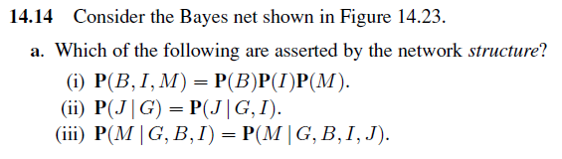
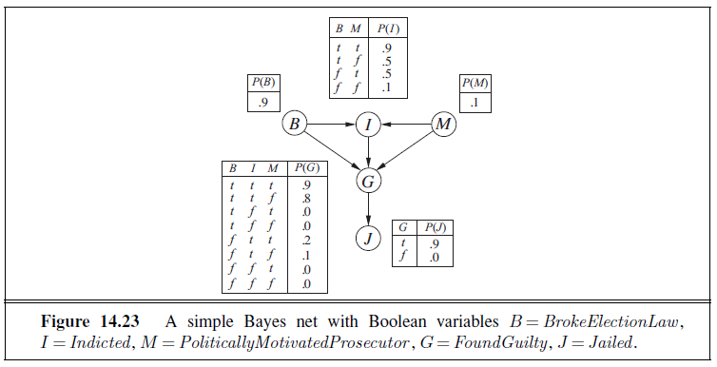
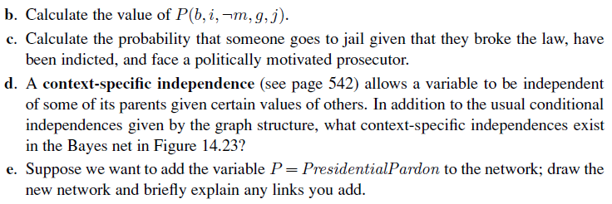

Slide 32
P(b, i, ¬m, g, j) =
P(j | g) P(g | b, i, ¬m) P(i | b, ¬m) P(b) P(¬m)
=0.9 * 0.8 * 0.5 * 0.9 * (1 - 0.1)

Slide 33
P(j | b, i, m) = P(j | g)P(g | b, i, m) +
P(j | ¬g)P(¬g | b, i, m)
= 0.9 * 0.9 + 0 * 0.1 = 0.81

Slide 34
D.
G is independent on B and M given I=False since P(G | B, ¬i, M) = 0 = P(G | ¬i)
E.
A pardon is unnecessary if the person is not indicted or not found guilty; so I and G are parents of P. One could also add B and M as parents of P, since a pardon is more likely if the person is actually innocent and if the prosecutor is politically motivated. The pardon (presumably) is a get out- of-jail-free card, so P is a parent of J.

Slide 36
Dependency
E
A
J
E
A
J
A
A
M
J
M
J
E
B
E
B
A
A

Slide 37
